Slide 1
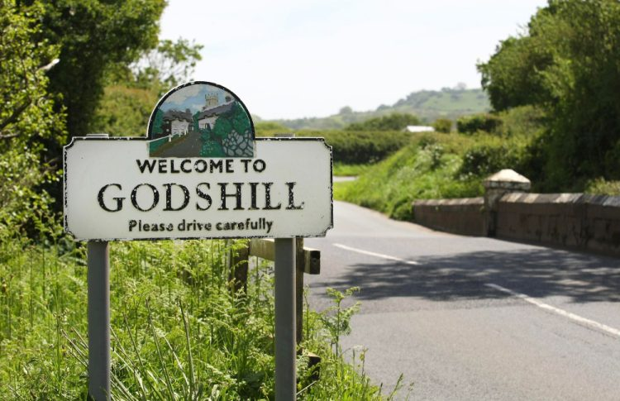
High Street & School Road, Godshill
Carriageway Reconstruction and Resurfacing

Slide 2
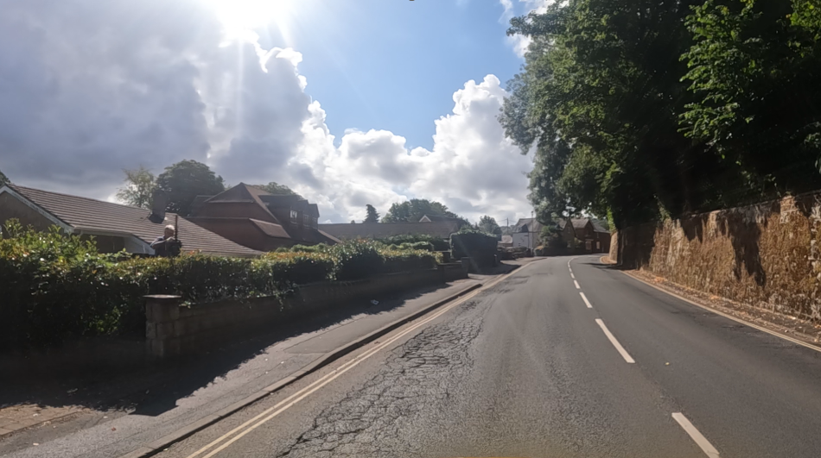
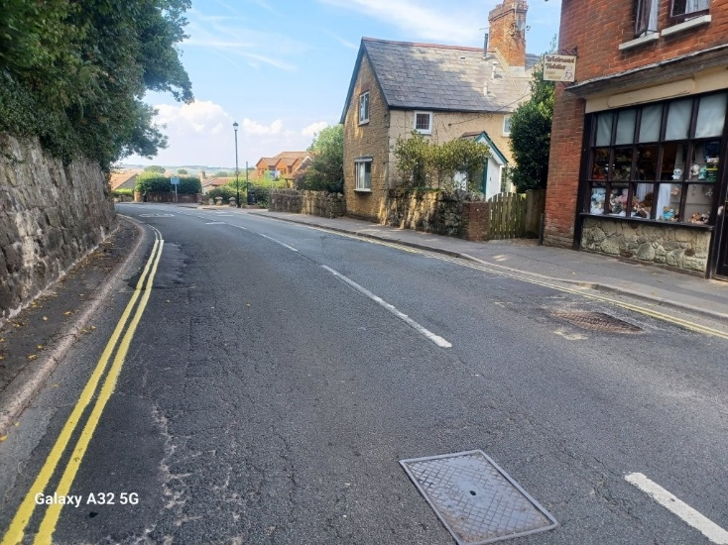
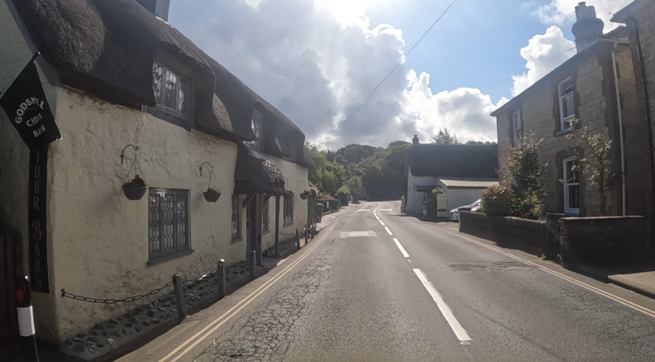
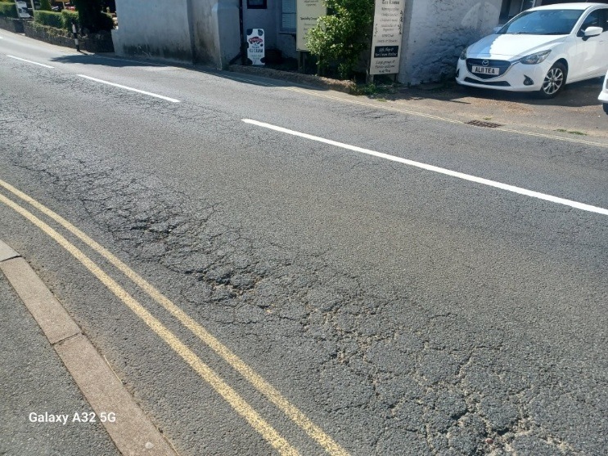
Road Condition

Slide 3
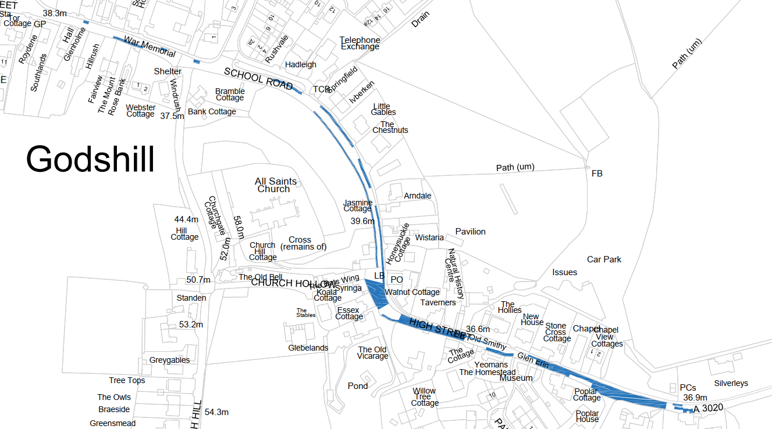
Scope of Works
Various dig depths of 80mm, 100mm & 240mm

Slide 4
Challenges
Access
School – half term (19 – 30 October)
Businesses – including trade during half term & Halloween
Residents
Parking
Pedestrian safety - sections without footways
Traffic - through traffic & rat running

Slide 5
Challenges
Delivery
Adverse weather
Low temperatures - laying & compacting materials
Reduced daylight hours
Location of defects
Depth of excavations – up to 240mm deep
Safety of road users and our staff during works
Unmapped underground services

Slide 6
Challenges
Timing
Months | Challenges
April – August | Peak tourism period but ideal conditions for highway works
September | Late tourism period
October | Half term holidays
November – mid December | Tourism businesses close until Easter
21st December – 3rd January | Christmas holidays
Jan, Feb, early March | Increased risk of lost shifts due to poor weather & low temperatures
26th March | Good Friday

Slide 7
Two Stages
STAGE | WORK | WHEN
1 | Reconstruction Localised deep repairs | Autumn / Winter 2026
2 | Resurfacing Whole road resurfacing | Spring 2027 (nights)

Slide 8
STAGE 1 : Reconstruction
Change of dates following visits to businesses
Revised dates - 2nd November - 15th January
Road space - until 29th January if required
Pause - 11th December – 4th January for Christmas trade
24 hour closure – 3 phases
Open weekends where possible
Event - “Christmas Cracker” on Saturday 5th December

Slide 9
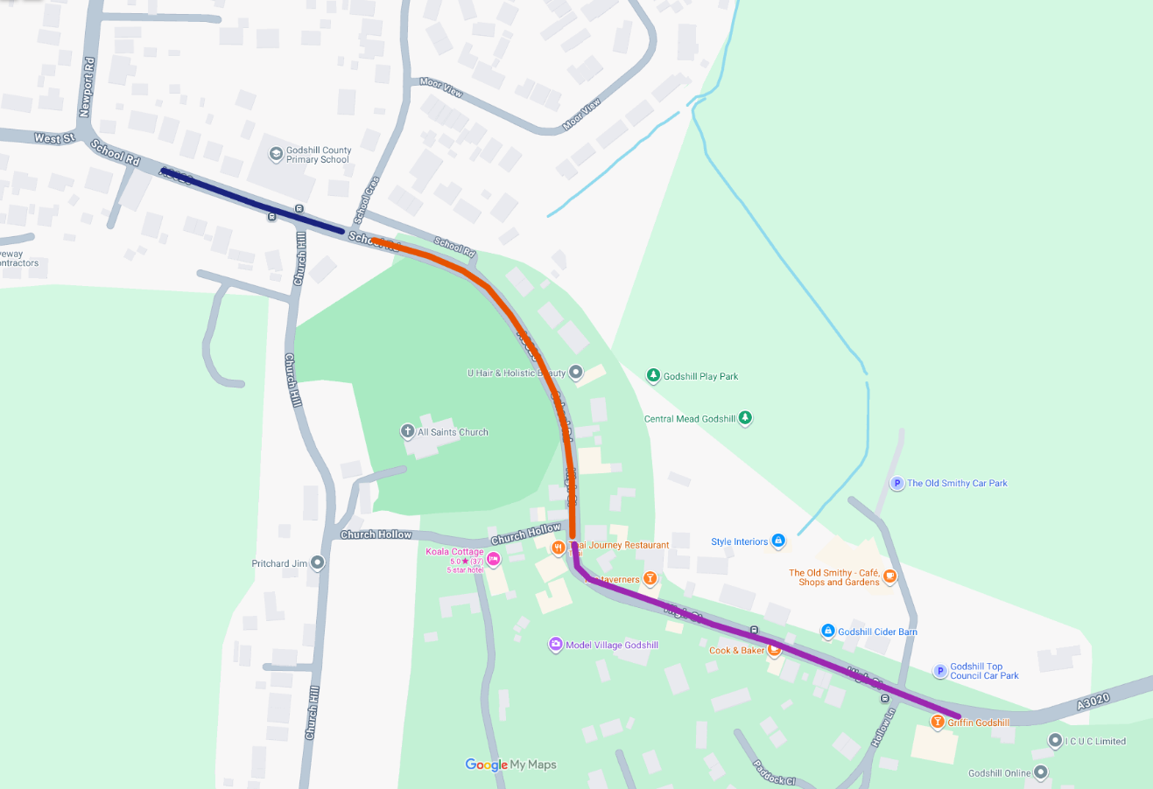
Phases
3 Phases

Slide 10
Phases
Phase 1
East of West Street to west of School Crescent

Slide 11
Phases
Phase 2
East of School Crescent to Church Hollow (inc junction)

Slide 12
Phases
Phase 3
South of Church Hollow to approx 100 metres east of Hollow Lane.

Slide 13
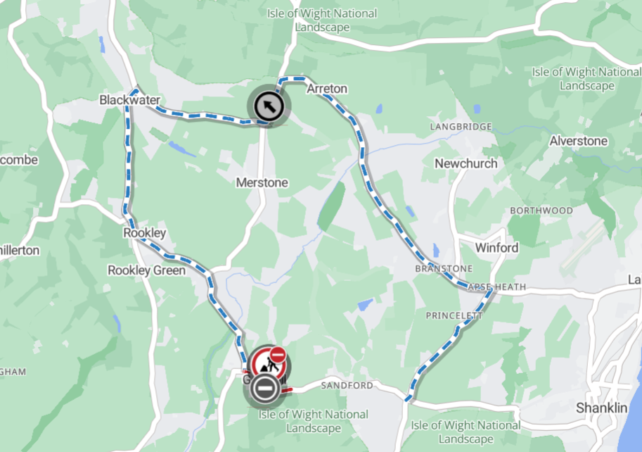
Signed Diversion Route

Slide 14
STAGE 2 - Resurfacing
Plane and resurface entire road
Likely April 2027
Approx 4 -5 nights (19:30 – 07:00)
Reopen during the day (temporary surface)

Slide 15
Communications
Businesses
Letters to residents
Press releases
Email bulletins
Website FAQs
Signage
Use of ‘X’ (formerly Twitter)

Slide 16
QUESTIONS

